Slide 1

Unit 1

Slide 4

Vocabulary

Slide 5

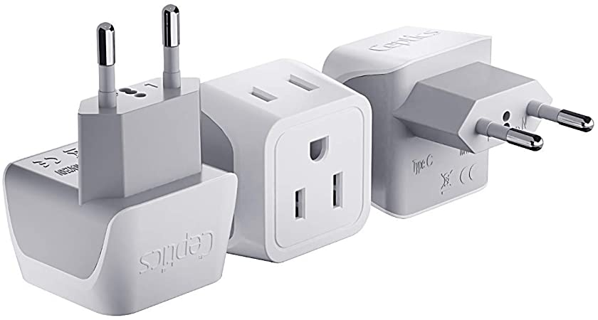
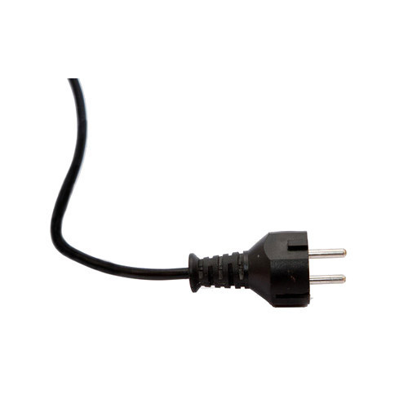
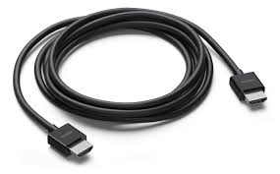
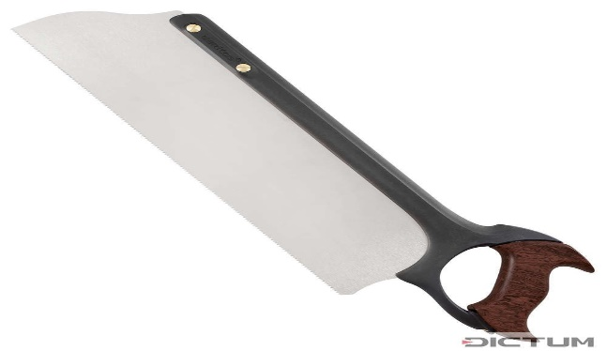
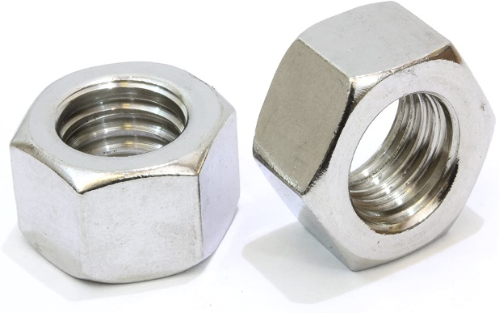
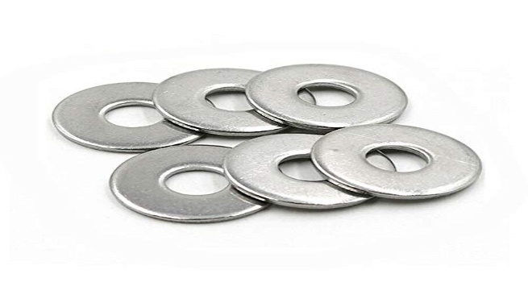
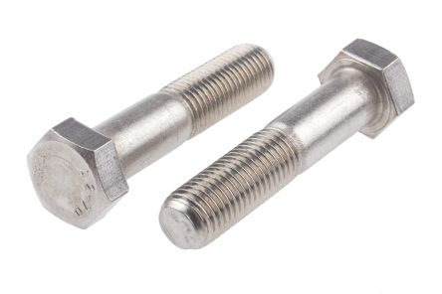
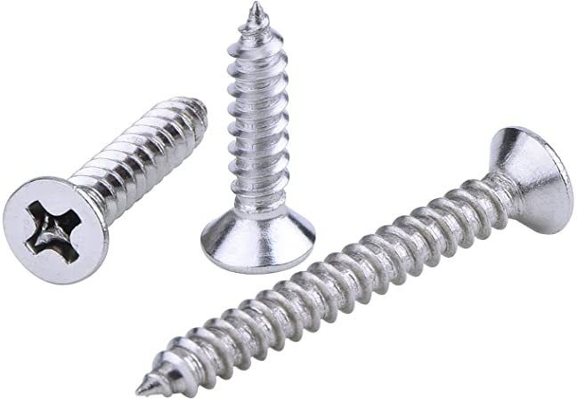
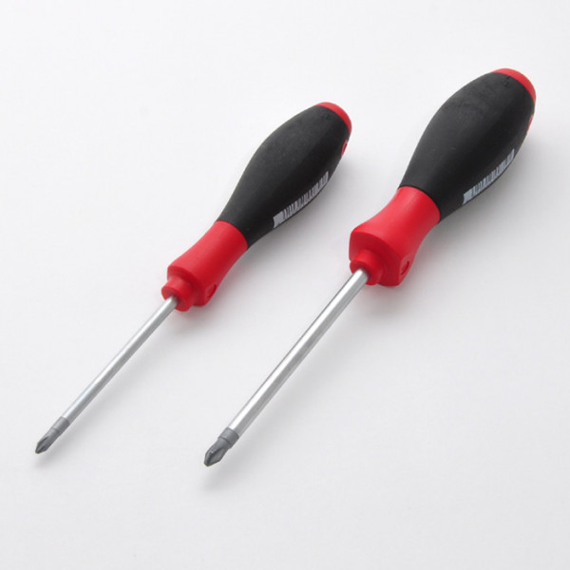
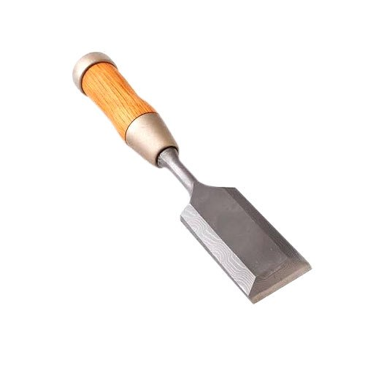
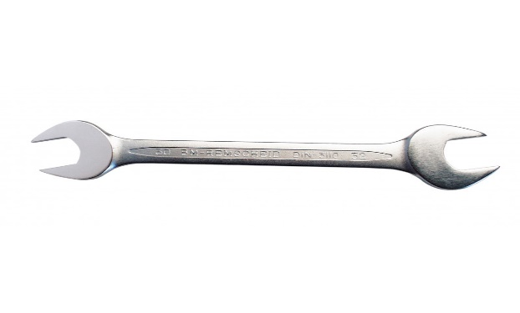
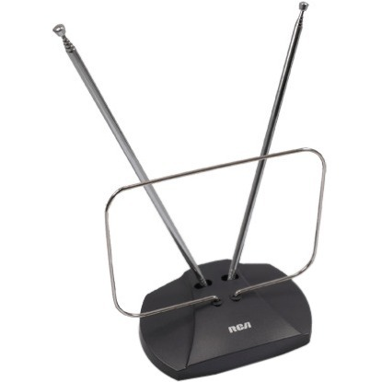
This is a/an ……

Slide 6
Match the pictures with the words in the box
adapter - antenna - bolts - cable - chisel - nuts - plug - saw - screws - screwdriver - spanner - washers

Slide 7

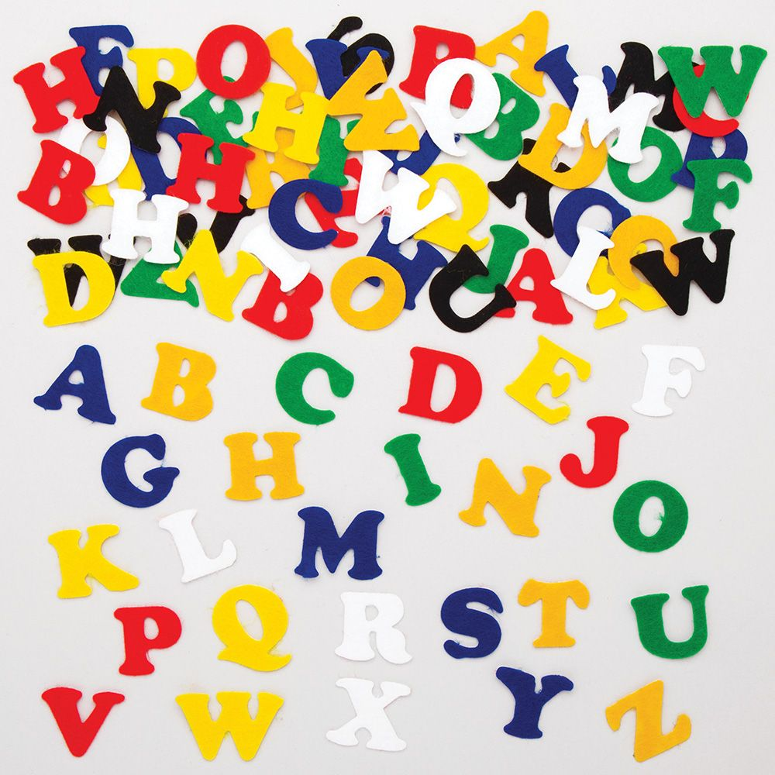
Unit 1 2. Letters and numbers

Slide 8

Listen and correct the four mistakes in the business card.

Slide 9
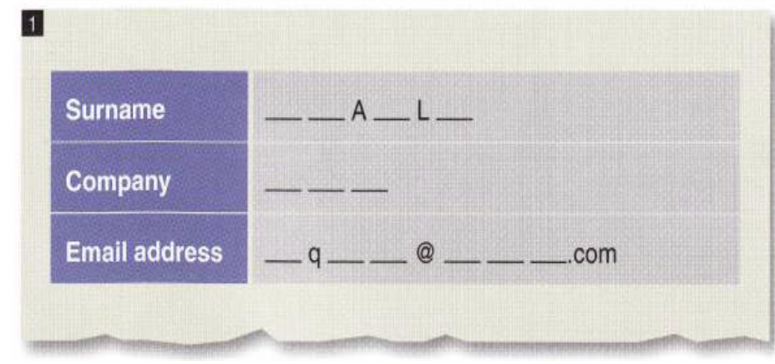
لقب\اسم العائله
شركة

Slide 10

TIME FOR A COMPETITION!

Slide 11
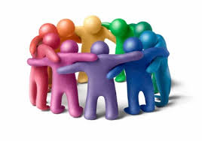
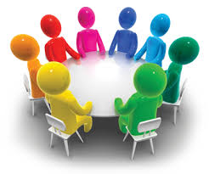
Work in groups. Have a spelling competition
1- Team A: Make a list of ten countries. Check the spelling. Then ask Team B to spell them correctly.
2- Team B: Make a list of ten capital cities. Check the spelling. Then ask Team A to spell them correctly.
Example: How do you spell EGYPT? How do you spell TOKYO?

Slide 12
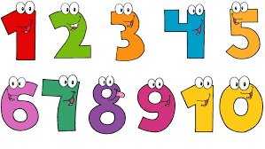
Numbers

Slide 13
Choose 4 numbers from 1-20.
Bingo!

Slide 14
1
2
3
4
5
One
Two
Three
Four
Five
6
7
8
9
10
Six
Seven
Eight
Nine
Ten

Slide 15
Numbers from 11-19
11
12
13
14
Eleven
Twelve
Thirteen
Fourteen
15
16
17
18
19
Fifteen
Sixteen
Seventeen
Eighteen
Nineteen

Slide 16
Multiples Of Ten
10
20
30
40
50
Ten
Twenty
Thirty
Forty
Fifty
60
70
80
90
100
Sixty
Seventy
Eighty
Ninety
Hundred

Slide 18

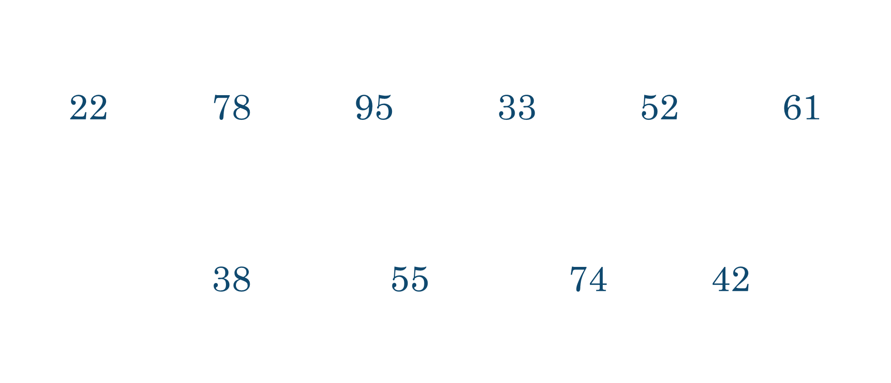
Let’s Practice!

Slide 19

Hundreds
100 = one hundred
200 = two hundred
300 = three hundred

Slide 20

…….. hundred and …….. Example: 125 One hundred and twenty-five
When talking we say “and”, but when writing we DON’T write it.
Hundreds
Let’s practice!
456 723 193 988
444 361 892

Slide 21
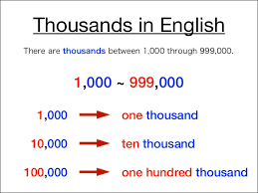
Thousands
1,000 = one thousand
2,000 = two thousand
3,000 = three thousand

Slide 22
Thousands
Example: 2,753
two thousand, seven hundred and fifty-three
Example: 34,812
thirty-four thousand, eight hundred and twelve
Example: 694,254
six hundred and ninety-four thousand, two hundred and fifty- four

Slide 23

Let’s Practice!
48 943 832 922 9 643
13 597 20 399

Slide 24

See you!

